Slide 1
When and why does ApET work?
CSE590 · MIDTERM PROGRESS
Understanding reconstruction-based visual token compression in LLaVA-1.5-7B
APET IN ONE LINE
SIMPLE, AND STRONG
OUR QUESTION
Without attention, keep visual tokens that are hard to reconstruct linearly; average the rest into their most similar kept token.
With 64 of 576 tokens, LLaVA-1.5 keeps 95.2% of its performance (VisionZip: 92.7%) and runs 1.46× faster.
How can a linear, geometric criterion work inside a nonlinear VLM, and when does it fail?
Peng Chen · SBU ID 117702477 · October 2026
Paper: Q. Ma et al., “ApET: Approximation-Error Guided Token Compression for Efficient VLMs,” CVPR 2026. Middle-column numbers are from this paper.
Notes:
ApET is a training-free method that shrinks the visual tokens of a vision-language model without looking at attention. It reconstructs every token as a linear combination of a few basis tokens, keeps the tokens with the largest reconstruction error, and averages each remaining token into its most similar kept token. The method is very simple, yet the paper reports strong results: on LLaVA-1.5, keeping only 64 of 576 tokens still gives 95.2 percent of the original performance, better than VisionZip, and inference is about 1.46 times faster. That raises our question: how can a linear, geometric criterion work so well inside a nonlinear model, and when does it fail?

Slide 2

Method and three research questions
Image
CLIP encoder
ApET stage 1
LLM
ApET stage 2
LLM
336×336
576 tokens
keep K₁
blocks 1–16
keep K₂
blocks 17–32
Setup: LLaVA-1.5-7B · native ApET code · Kaggle 2×T4, locked environment · GQA 800, MMStar 1,500, TextVQA 100 · avg. 64 or 192 tokens
RQ1 · Does E track answer relevance?
RQ2 · Selection or merging?
RQ3 · A lightweight improvement?
Planned at matched budgets: E vs. random selection; merge vs. drop vs. random or protected merge targets.
30-question diagnostic set. Information Horizon (IH) test: keep only one token, measure its effect on the answer, correlate with E.
Only if the analysis supports it, e.g., an adaptive token budget. Exploratory.
Pilot: random sometimes beat ApET, so we first ran ApET vs. random at scale.
E = reconstruction error from 10 basis tokens; merging averages each dropped token into its most similar kept token. · 2 / 5
Notes:
Here is ApET in LLaVA-1.5. The image becomes 576 tokens, and ApET compresses twice: after the vision encoder and again after block 16. Inside each stage it picks 10 basis tokens, keeps the tokens with the largest reconstruction error, and averages the rest into similar kept tokens. Our setup: LLaVA-1.5-7B with the native ApET code on Kaggle, three datasets, and two budgets that average 64 or 192 tokens. RQ1 asks whether the error E tracks what the answer needs; we test this on a 30-question diagnostic set with an Information-Horizon-style test that keeps only one token at a time. RQ2 asks whether ApET’s strength comes from selection or from merging; the plan compares E-based with random selection, and merging with dropping or other merge targets. In pilot tests, random selection sometimes kept answers ApET lost, so we first ran a large comparison of ApET against random pruning. RQ3, a lightweight improvement, stays exploratory.

Slide 3
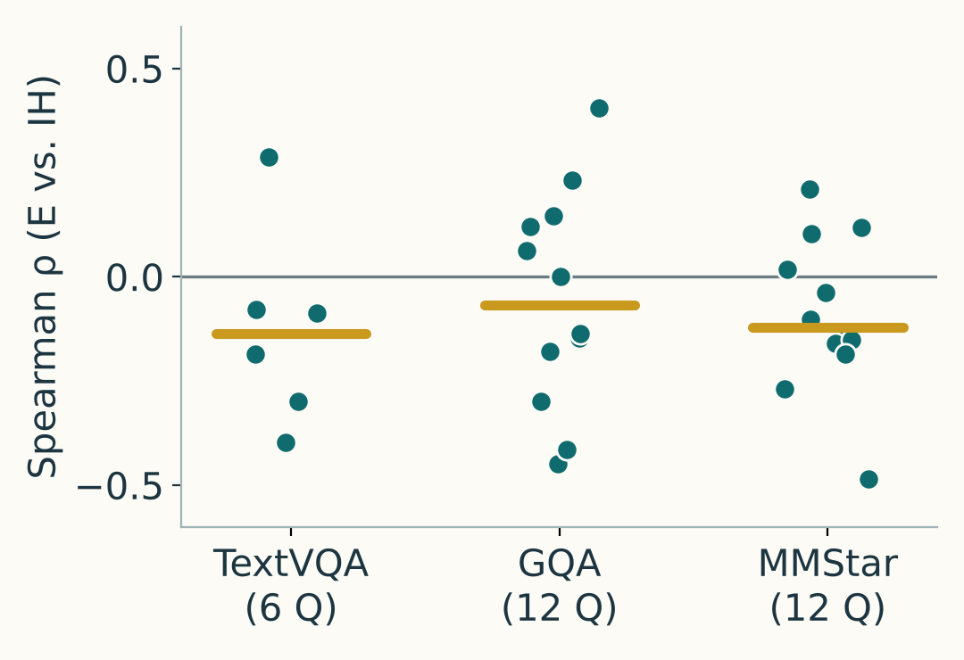
ApET works on average, but not answer by answer
① E does not predict which tokens matter
② Yet ApET beats random pruning, task-dependently
③ Similar accuracy hides answer turnover
IH test: keep only one of 576 visual tokens and measure how much it raises the answer’s probability. 30 questions, 17,280 token tests.
Accuracy (%) at the same budget (avg. 64 tokens); random = mean of 3 seeds.
ApET versus the uncompressed model, at avg. 192 tokens:
Uncompressed
ApET
Random
GQA · 800 questions
TextVQA, 100 Q · ApET +20.9 pts
34 lost · 26 gained
49.7
Accuracy 69.0% → 68.0%
41.5
20.6
MMStar · 1,500 questions
GQA, 800 Q · ApET +2.5 pts
36 lost · 40 gained
69.0
Accuracy 34.7% → 35.0%
63.8
Medians −0.07 to −0.14; only 11 of 30 questions positive.
61.3
Lost = correct → wrong. Gained = wrong → correct.
IH: Information-Horizon-style retain-one test [Wang et al. 2026] · ① uses 30 hand-picked diagnostic questions · 3 / 5
Notes:
We have three findings. First, RQ1. We used an Information-Horizon-style test: keep only one of the 576 visual tokens, and measure how much that single token raises the probability of the correct answer. We did this for every token in 30 diagnostic questions, which is 17,280 token tests. Then, for each question, we checked whether ApET’s reconstruction error ranks tokens the same way. It does not: the median correlation is slightly negative in all three datasets, and only 11 of 30 questions show a positive correlation. So, token by token, “hard to reconstruct” is not the same as “useful for the answer.” Second, the surprise: complete ApET still beats random pruning at the same budget. On TextVQA, with 64 tokens on average, ApET scores 41.5 versus 20.6 for random — about 21 points better. On GQA the gap is only 2.5 points. So ApET’s advantage depends strongly on the task. Third, ApET’s good average accuracy hides a lot of change in individual answers. Compared with the uncompressed model at 192 tokens, on 800 GQA questions ApET turns 34 correct answers wrong but 26 wrong answers right, so accuracy only drops from 69 to 68 percent. On MMStar it loses 36 and gains 40, so accuracy even goes up slightly. Compression reshuffles which questions are answered correctly, in both directions.

Slide 4
Roadblocks and fixes
Independent issues, each with its own fix and status
Roadblock | Problem | Attempted fix | Current status
Integration | Kaggle package updates broke ApET/LLaVA compatibility. | Locked environment with recorded fixes. | Green: resolved
Run-to-run variation | Fresh compressed runs changed a few answers; replays from saved features were identical. | Diagnostic traced it to the merge step (likely order-dependent FP16 sums); keep first runs, repeat critical cases. | Yellow: managed, cause not isolated
Selection bias | The 30-question set was picked from ApET’s own outcomes, so it favors other methods. | Use it only for RQ1 and case studies; compare components on unselected subsets. | Yellow: handled by design
Planning risk | Component attribution may stay unclear; no RQ3 candidate yet. | Report a well-controlled negative result if needed. | Yellow: open
Merging uses CUDA scatter_add_; GPU additions can run in a different order each time, and FP16 addition is not exactly associative. · 4 / 5
Notes:
These are separate problems, each with its own fix. Integration: package updates on Kaggle broke compatibility; a locked environment solved it. Run-to-run variation: re-running the same compressed setting from scratch changed a few answers, while replays from saved features did not. A diagnostic showed everything was identical up to the merge step; the likely cause is that the GPU adds merged tokens in a different order each run, which slightly changes 16-bit results. We keep first runs as official results and repeat any case a conclusion depends on. Selection bias: our small diagnostic set was chosen from ApET’s own outcomes, which favors other methods, so we use it only for RQ1 and case studies. Finally, a planning risk: if we cannot pin down which component matters, we will report a careful negative result.

Slide 5
What’s next
01 · RQ2 selection
02 · RQ2 merging
03 · RQ3, exploratory
Does linear reconstruction pick what the model uses?
Should we merge, and how?
A lightweight improvement?
Merge vs. drop vs. random or protected targets; measure how averaged tokens differ from the originals.
Only if the analysis supports it, e.g., a question-aware budget. No guarantee.
Vary only selection, merging fixed. For low-E tokens: kept, merged, dropped, or replaced by their linear reconstruction.
SUCCESS CRITERION
One controlled comparison isolating a single ApET component on ≥100 unselected questions: matched budgets, 3 seeds, paired 95% intervals. Negative results count.
Protocol Nov 6 · pilot Nov 13 · main run Nov 20 · RQ3 go/no-go Nov 24 · final Dec 15 · 5 / 5
Notes:
Next steps. First, continue RQ2 on selection: does linear reconstruction pick the tokens the model actually uses? We will vary only the selection rule with merging fixed, and for low-error tokens compare keeping, merging, dropping, or replacing them with their linear reconstruction. Second, continue RQ2 on merging: should we merge at all, and how? We will compare merging, dropping, and random or protected merge targets, and measure how the averaged tokens differ from the originals. Third, RQ3 stays exploratory: a lightweight improvement, such as a question-aware budget, only if the analysis supports it. Our success criterion is one controlled comparison that isolates a single ApET component on at least 100 unselected questions, with matched budgets, three seeds, and paired confidence intervals. A clear negative result also counts. The timeline runs from a written protocol on November 6 to the final report on December 15.

